Slide 1
Social Media-Analysis Sentiment
This project focuses on sentiment analysis of social media data collected from multiple platforms such as Twitter, Instagram, and Facebook. The goal is to analyze user-generated content to identify emotional expressions, understand engagement patterns, and uncover trending hashtags across various countries and time zones. By examining sentiments, platform usage, post timing, and audience interactions (likes and retweets), the project provides actionable insights into public opinion and digital engagement behavior.
--Priya Rajurkar

Slide 2
Project Overview:
This project involves analyzing a sentiment dataset derived from social media posts across platforms like Twitter, Facebook, and Instagram. The dataset contains information such as text content, user sentiment, posting time, platform, location, and engagement metrics like likes and retweets. The objective is to understand the emotional tone expressed in the posts and identify patterns in user behavior, platform activity, and regional engagement.
Using Python and data analysis techniques, we extracted key insights such as the most common sentiments, peak hours of posting, top countries contributing to the data, and the most engaging content based on likes and retweets. Additionally, we explored trending hashtags to understand what topics are resonating with users. These insights can be valuable for businesses, marketers, and researchers aiming to enhance social media strategies, monitor brand sentiment, or study public opinion trends.

Slide 3
Technologies Used:
This project was developed using Python for data analysis and visualization. Key libraries included Pandas for data manipulation, Matplotlib and Seaborn for creating visual insights, and Collections and Regex for processing and analyzing hashtags. The dataset was handled in CSV format and analyzed in a Jupyter Notebook environment to explore trends, distributions, and engagement metrics across different dimensions such as sentiment, time, and platform

Slide 4


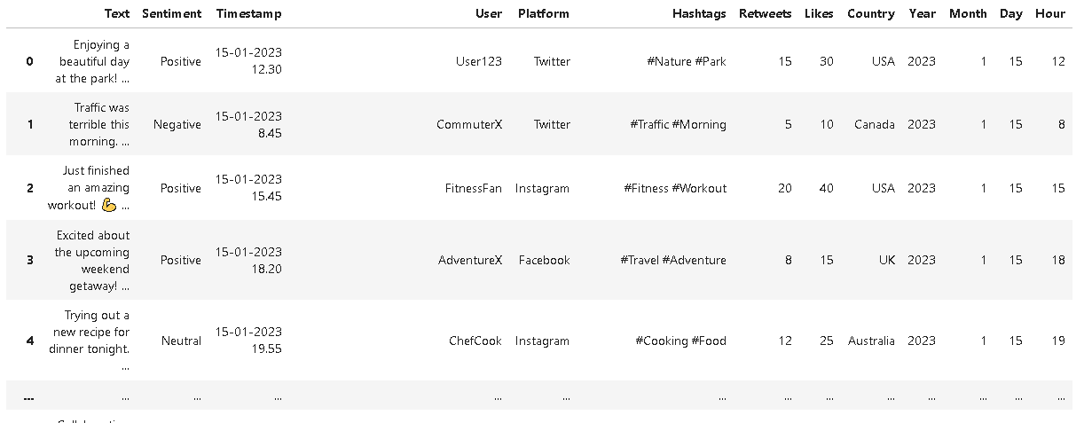
Step 1 – Importing Libraries and reading data

Slide 5
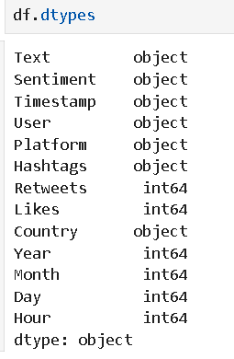
Step 2 – Checking Data Types

Slide 6
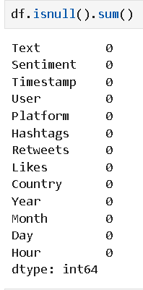
Step 3 – Finding Null Values

Slide 7
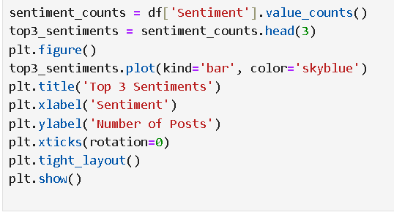
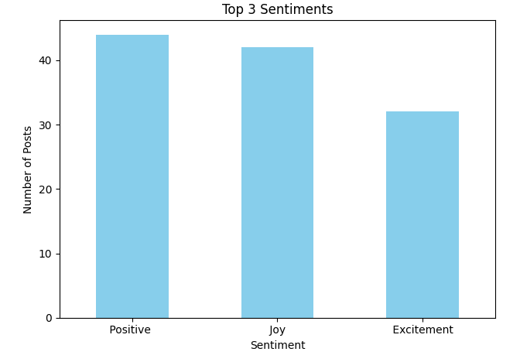

Step 4- Insights
1] Sentiment Distribution Plot

Slide 8
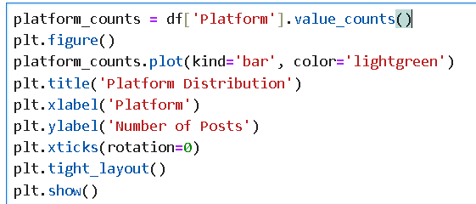

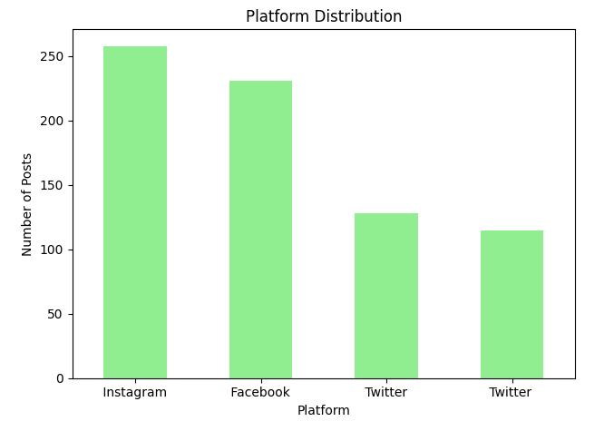
2] Platform Distribution Plot

Slide 9
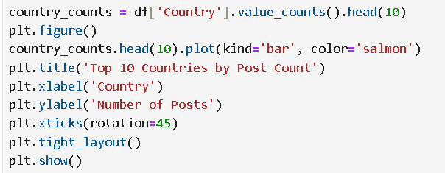
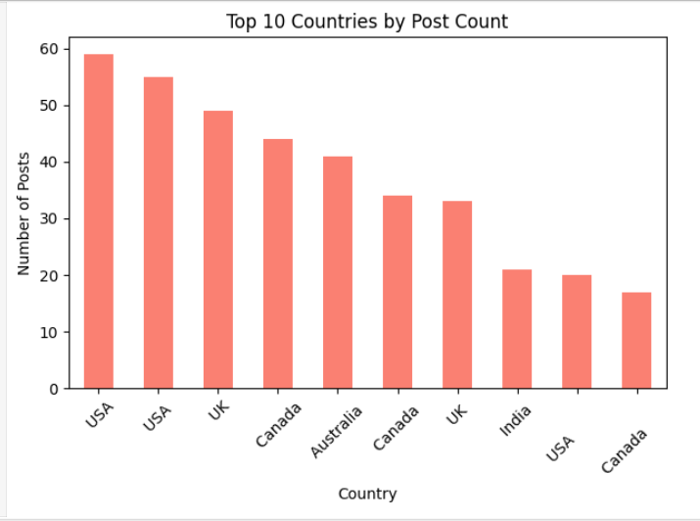
3] Country Distribution Plot (Top 10)

Slide 10
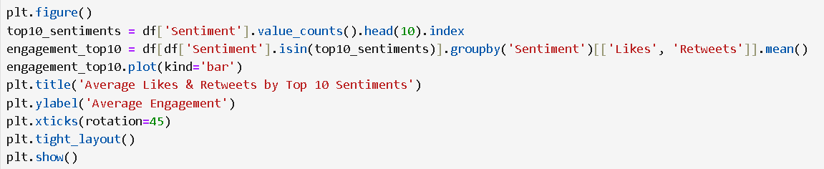
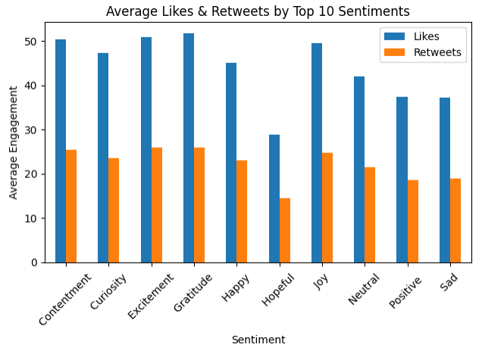
4] Engagement Analysis Plot (Likes & Retweets by Top 10 Sentiments)

Slide 11
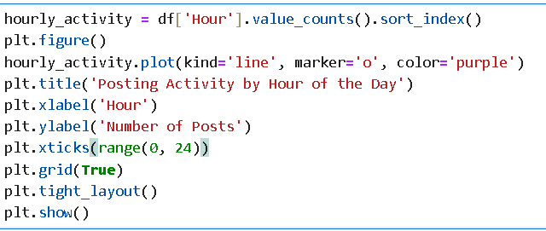
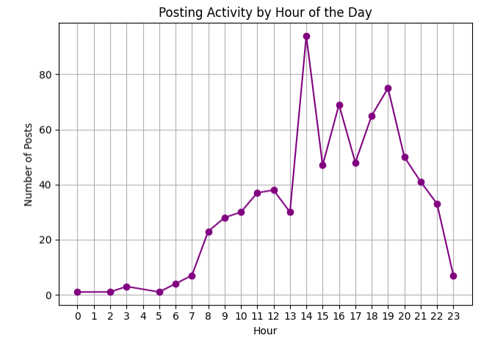
5] Activity by Hour Plot

Slide 12
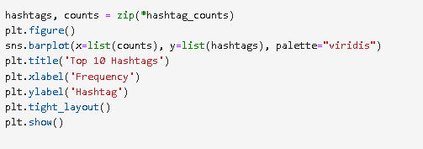
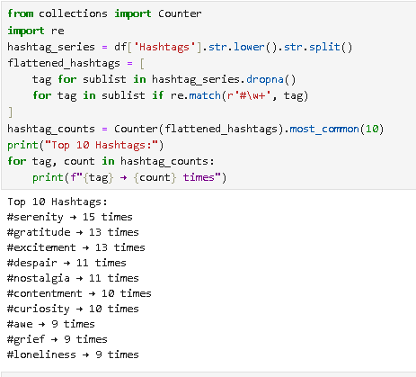
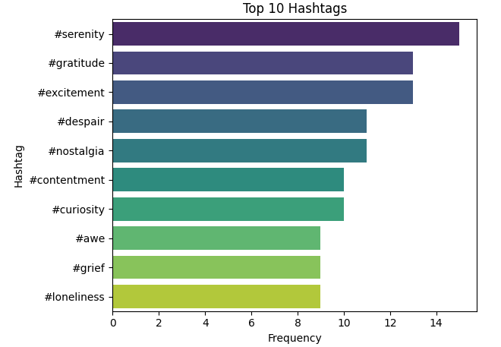
6] Top Hashtags Plot

Slide 13
Project Summary:
In this project, we conducted a comprehensive sentiment analysis on social media data to uncover user emotions, platform activity, and engagement trends. By leveraging Python and data visualization tools, we identified the most common sentiments, top-performing hashtags, active posting hours, and regional distribution of posts. The insights derived from this analysis provide a deeper understanding of public mood and behavior across platforms, offering valuable guidance for content strategy, audience targeting, and digital engagement. Overall, the project demonstrates how data-driven approaches can turn raw social media information into meaningful and actionable insights.

Slide 14
Thank you
-- Priya Rajurkar

